Slide 1

Cloud Principles
Topic 1

Slide 2
Lesson Objectives
Objective 1: Understand the difference between cloud computing and on-premise computing.
1
Objective 2: Learn how to access major cloud platforms via portals, APIs, and SDKs.
2
Objective 3: Explore the definition, characteristics, and advantages of cloud computing.
3
Objective 4: Understand the relationship between Cloud Computing and Service-Oriented Architecture (SOA).
4
Objective 5: Discuss enterprise cloud drivers and adoption trends.
5

Slide 3
What is Cloud Computing?
"Cloud Computing is the delivery of computing services (servers, storage, databases, networking, software, analytics, etc.) over the internet ('the cloud')."

Slide 4
On-Premise vs Cloud
On-Premise Computing:
Infrastructure managed internally.
Requires significant upfront capital expenditure.
Scalability is limited by hardware availability.
Cloud Computing:
Infrastructure managed externally by cloud providers.
Follows a pay-as-you-go model.
High scalability and flexibility.

Slide 5
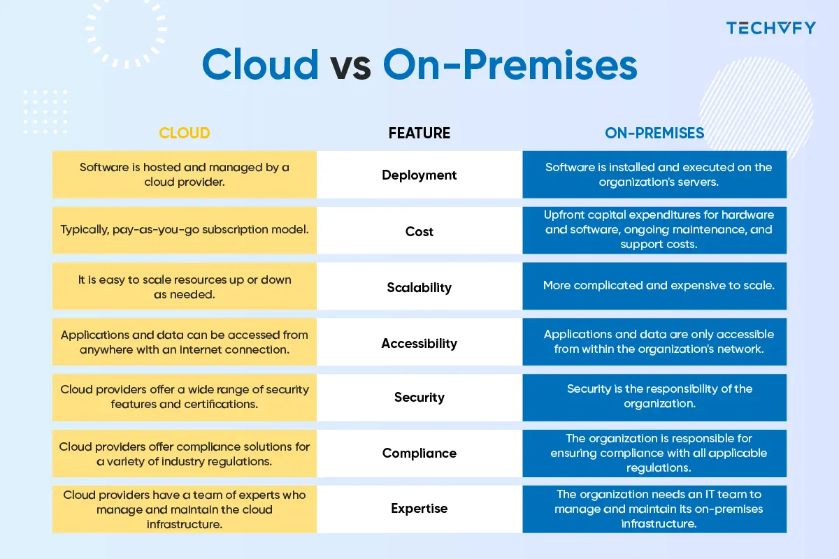

Slide 6
Cloud Access Methods
Portals: Web-based dashboards for cloud service management (e.g., AWS Management Console).
APIs: Programmatic access for automated tasks and integrations.
SDKs: Language-specific libraries (e.g., AWS SDK for Python, Azure SDK for Java).

Slide 7
Cloud Computing Characteristics
Elasticity
Multi-Tenancy
On-Demand Access
Ubiquitous Access
Usage Metering
Self-Service Capability
SLA Monitoring

Slide 8
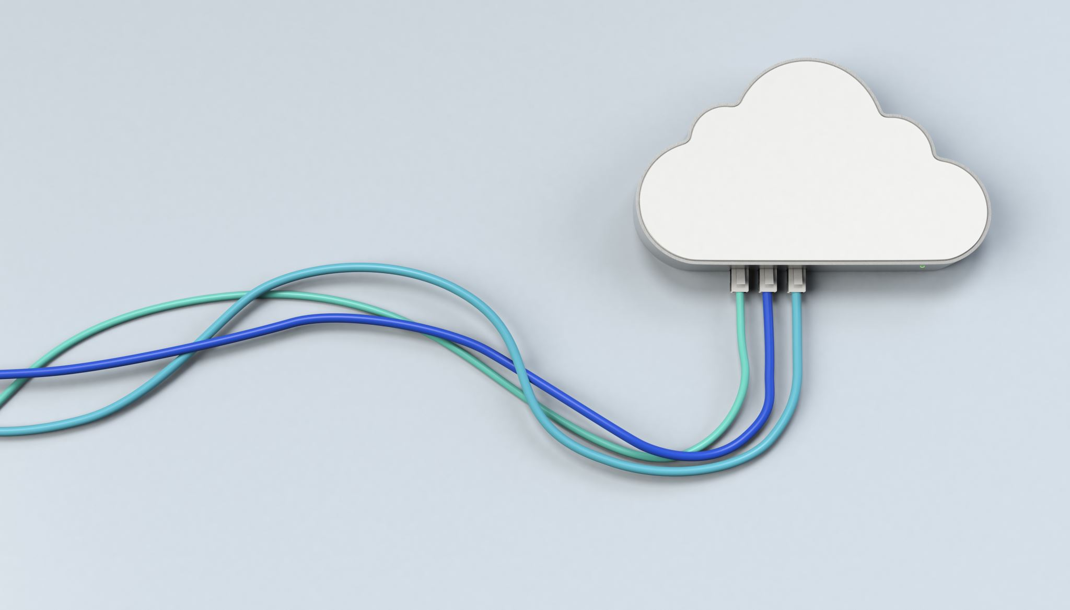
Elasticity
Elasticity refers to the ability to scale computing resources up or down dynamically based on current demand. This means if you have a sudden spike in user activity, the cloud can allocate additional resources automatically, and when demand drops, it reduces the resources to avoid wastage.

Slide 9
Multi-Tenancy
Multi-tenancy is a cloud architecture where multiple users (tenants) share the same physical infrastructure while keeping their data and applications isolated and secure.
A cloud provider like AWS hosts data for multiple organizations on the same server, but each organization's data is accessible only to them.

Slide 10

On-Demand Access
Users can access and use computing resources whenever they need them, without waiting for manual provisioning.
A developer can instantly spin up a virtual server or database instance with just a few clicks in a cloud portal or an API call.
Immediate resource availability.
Faster deployment of applications.
Improved flexibility and agility for businesses.

Slide 11

Ubiquitous Access
Cloud resources can be accessed from anywhere with an internet connection, using any compatible device, like a laptop, tablet, or smartphone.
Employees working remotely can access cloud-based productivity tools like Google Workspace or Microsoft 365 from any location.

Slide 12

Usage Metering
Cloud providers use metering systems to track resource usage, such as CPU, memory, storage, and bandwidth. Users are billed based on their actual consumption.
A cloud provider charges a company for storage in GB, compute power in hours, and data transfer in TB.

Slide 13

Self-Service Capability
Users can independently provision and manage resources through a self-service portal without needing intervention from the service provider’s support team.
A developer can create a virtual machine, configure it, and deploy an application directly from the cloud dashboard or CLI.

Slide 14

SLA Monitoring
Service Level Agreements (SLAs) define the expected level of service, such as uptime, performance, and response times. Cloud providers continuously monitor their systems to meet these commitments.
AWS provides an SLA of 99.99% uptime for certain services. If the uptime drops below this threshold, customers may receive compensation as per the SLA terms.

Slide 15
Service-Oriented Architecture (SOA)
Service-Oriented Architecture (SOA):
Framework for designing and developing software as modular services.
Relationship with Cloud Computing:
SOA principles enhance cloud computing by enabling service reuse, scalability, and flexibility.
Example: Microservices architecture commonly deployed in cloud environments.

Slide 16
Feature | SOA | Monolithic | Microservice | Event-Driven | Layered
Definition | Design paradigm structuring software as modular services communicating via protocols. | Entire application built as a single, unified unit. | Breaks down applications into small, highly specific services. | System communicates using asynchronous events. | Applications divided into layers like presentation, business logic, and data.
Modularity | Medium - Coarse-grained services focused on business processes. | Low - Single deployable codebase. | High - Each microservice handles a single functionality. | High - Components react to and produce events. | Medium - Organized into distinct functional layers.
Scalability | Scalable but may require more effort for inter-service communication. | Limited; scaling requires duplicating the entire application. | Highly scalable; services scale independently. | Highly scalable; can handle real-time workloads efficiently. | Limited; scalability depends on specific layer bottlenecks.
Interdependence | Loosely coupled services with some interdependencies. | Highly interdependent; components tightly coupled. | Loosely coupled with minimal interdependencies. | Minimally coupled; services interact indirectly via events. | Layers interact sequentially; moderately coupled.
Technology Flexibility | Supports heterogeneous technologies with protocols like SOAP/REST. | Requires uniform technology stack. | High flexibility; services can use different technologies. | Flexible; integrates with various messaging technologies (e.g., Kafka). | Relatively inflexible; layers depend on each other.
Use Cases | Enterprise systems, reusable services. | Small-scale applications or systems with simple requirements. | Large-scale, complex systems requiring agility (e.g., Netflix, Uber). | IoT, real-time notifications, stock trading platforms. | Traditional enterprise systems like CRM or ERP.
Advantages | Reusability, flexibility, promotes modular design. | Easy to develop initially, fewer moving parts. | Independent scalability, faster development cycles. | Low latency, resilient, real-time communication. | Clear separation of concerns, simplifies maintenance.
Challenges | Complex governance, potential performance overhead. | Hard to maintain and scale as the application grows. | Complex management; requires orchestration tools. | Debugging/tracing events is challenging; requires robust event handling. | Can introduce inefficiencies due to abstraction layers.

Slide 17
Enterprise Cloud Drivers
Cost reduction (CAPEX to OPEX shift).
Improved scalability and flexibility.
Faster time-to-market for applications.
Enhanced security features provided by cloud providers.

Slide 18

Adoption Trend
Increasing multi-cloud strategies.
Migration to hybrid cloud setups.
Growing reliance on AI and ML services in the cloud.

Slide 19
End of Topic 1

Slide 20
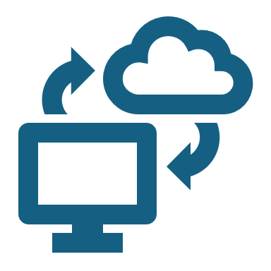
Architectural Layers of Cloud Computing
Topic 2

Slide 21
Contents
Introduction to Cloud Computing
Cloud Computing Layers
Software as a Service (SaaS)
Platform as a Service (PaaS)
Infrastructure as a Service (IaaS)
Dynamic Infrastructure
Summary & Q&A

Slide 22
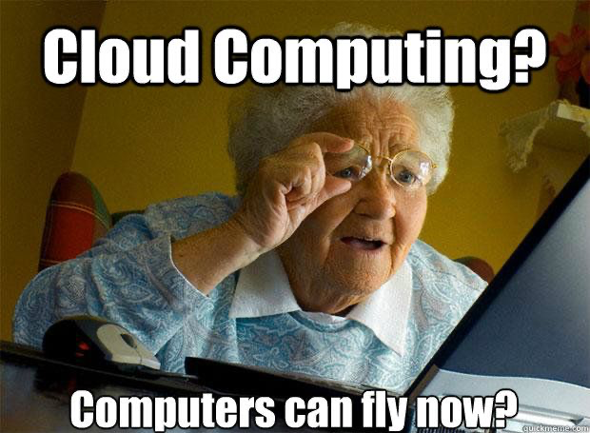

Slide 23
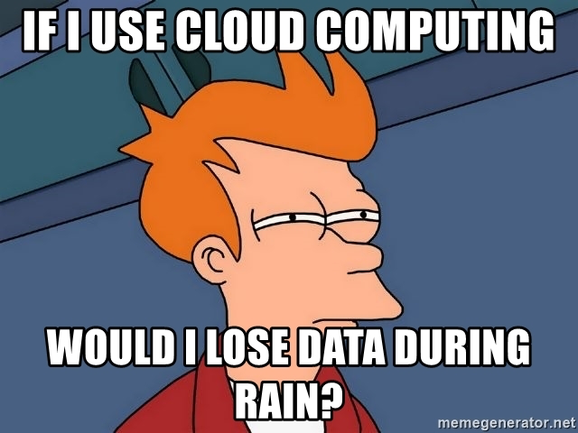

Slide 24
Introduction to Cloud Computing
Cloud computing is the on-demand delivery of computing services (servers, storage, databases, networking, software) over the internet.
Key Characteristics:
On-demand self-service
Broad network access
Resource pooling
Rapid elasticity
Measured service (pay-as-you-go)

Slide 25

Delivery of Computing Services
Servers
Storage
Databases
Networking
Software
Analytics
Artificial Intelligence

Slide 26
Why Cloud Computing?
Business Advantages:
Scalability for growing workloads
Cost-effective model (operational vs. capital expenses)
Faster deployment of new services
Global reach and availability
Technical Advantages:
Automated software updates
Simplified infrastructure management
Resilience and redundancy

Slide 27

Cloud Computing Layers
High-Level Layers in Cloud:
Infrastructure as a Service (IaaS)
Platform as a Service (PaaS)
Software as a Service (SaaS)
Goal: Abstract complexity for end users and businesses.

Slide 28

Understanding the Layered Model
Layered Approach:
Each layer builds upon the capabilities of the layer below.
Users at each layer only focus on resources they directly manage.
Analogy:
SaaS: The complete package (like using a fully-furnished apartment).
PaaS: The foundation to build upon (like an empty apartment where you bring your own furniture).
IaaS: The raw materials and space (like the land and building framework).

Slide 29

Software as a Service (SaaS)
Software distribution model in which applications are hosted by a third-party provider and made available over the internet.
Key Characteristics:
No local installation required
Subscription or pay-per-use pricing
Accessible via web browser or thin client
Examples:
Salesforce, Microsoft 365, Google Workspace (Gmail, Docs), Dropbox

Slide 30
SaaS – Benefits and Challenges
Benefits:
Quick deployment and minimal setup
Reduced IT overhead (maintenance, updates are handled by provider)
Access from anywhere, on multiple devices
Challenges:
Limited customization compared to on-premises software
Dependency on internet connectivity
Potential data privacy and compliance concerns

Slide 31
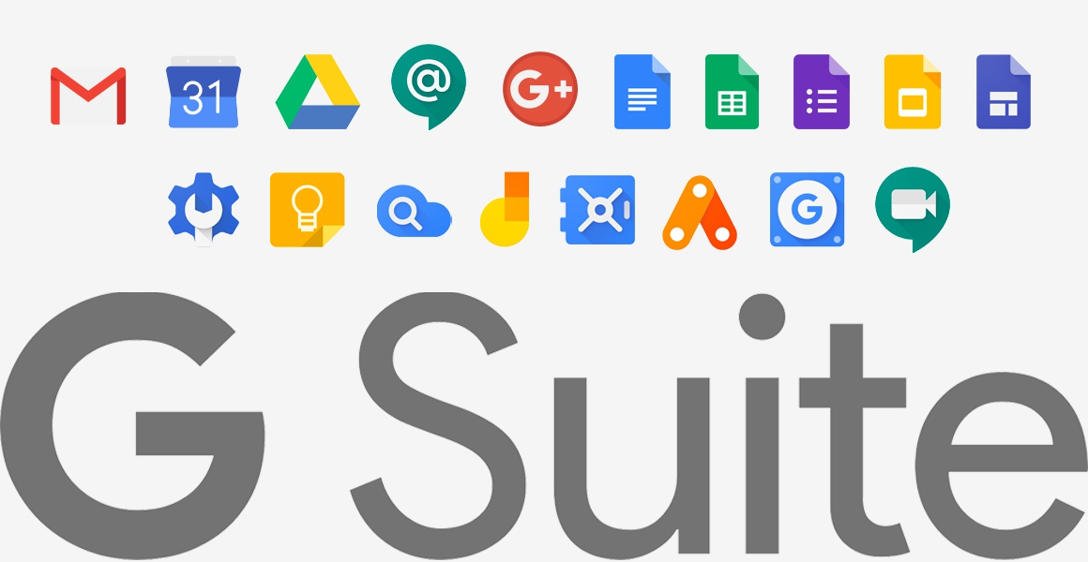
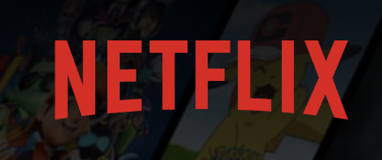
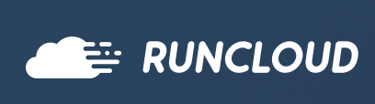
Software As A Service (SAAS)

Slide 32

Platform as a Service (PaaS)
A set of tools and services designed to make coding and deploying applications quick and efficient.
Providers manage the underlying infrastructure; developers focus on the application itself.
Key Components:
Runtime environment (language runtimes, frameworks)
Development tools
Databases and integration services

Slide 33
PaaS – Benefits and Challenges
Benefits:
Simplifies development and deployment
Less complexity in managing servers, storage, or networking
Automated scalability
Challenges:
Might be restricted to provider-specific tools/languages
Risk of “vendor lock-in”
Costs can grow if the application scales rapidly

Slide 34
Examples of PaaS Providers
Major PaaS Offerings:
Heroku (Salesforce)
Google App Engine (Google Cloud Platform)
Azure App Service (Microsoft Azure)
AWS Elastic Beanstalk (Amazon Web Services)
Key Services Offered:
Hosting environments
Integrated development environments (IDEs)
Database and storage integrations

Slide 35
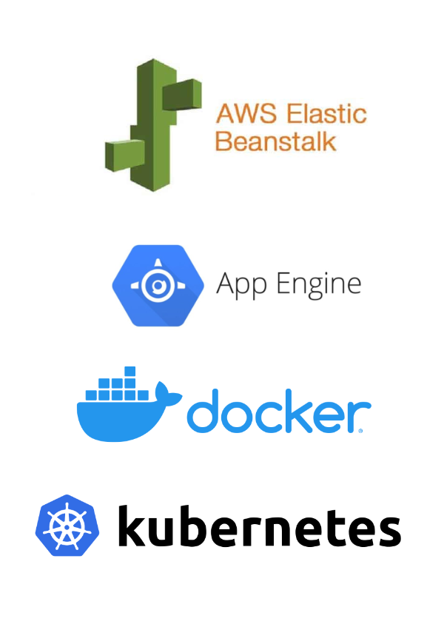
Platform As A Service (PAAS)

Slide 36
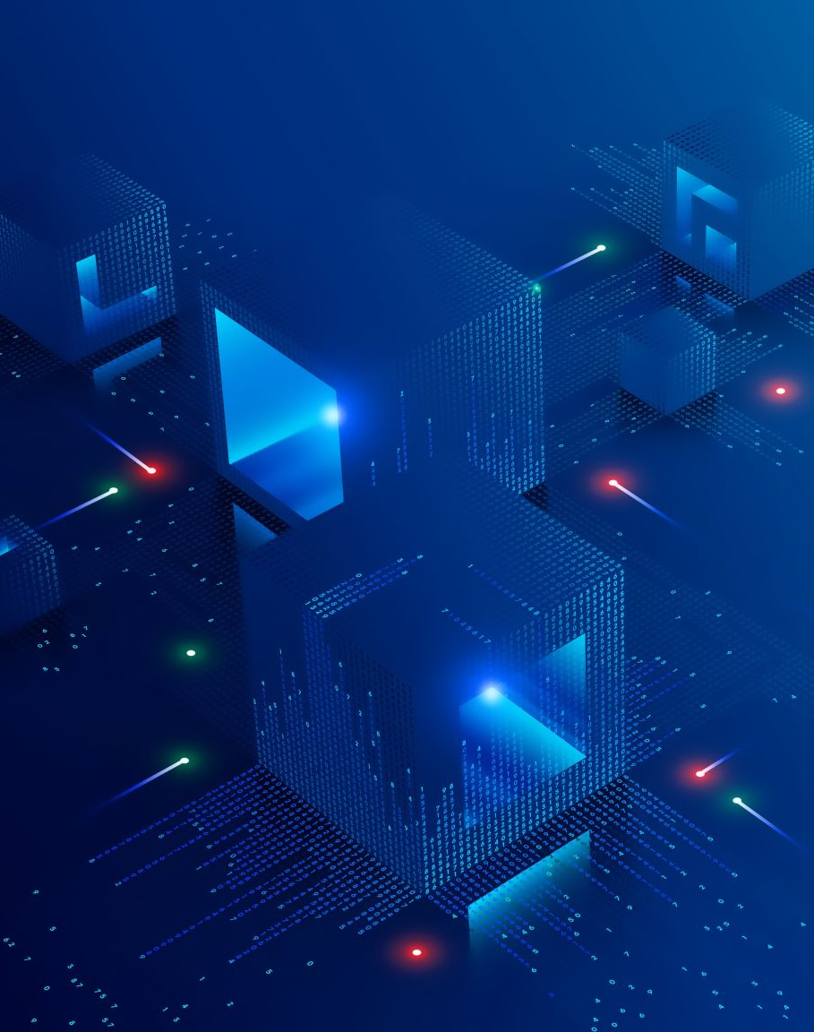
Infrastructure as a Service (IaaS)
Virtualized computing resources over the internet, including servers, storage, and networking hardware.
Users install and manage operating systems, applications, and middleware on provided infrastructure.
Key Components:
Virtual machines (VMs)
Storage (object, block, file)
Networking (virtual networks, firewalls, load balancers)

Slide 37
IaaS – Benefits and Challenges
Benefits:
High flexibility and control over resources
Pay-as-you-go model for infrastructure
Easy scalability and rapid provisioning
Challenges:
Requires in-house expertise to configure and manage
Security and compliance are partly the customer’s responsibility
Potential complexity in managing virtual machines and networks

Slide 38
IaaS Providers and Use Cases
Major IaaS Providers:
Amazon Web Services (EC2, S3, etc.)
Microsoft Azure (Virtual Machines, Azure Storage)
Google Cloud Platform (Compute Engine, Cloud Storage)
Typical Use Cases:
Hosting web applications
Big data processing
Backup and disaster recovery
Development and testing environments

Slide 39
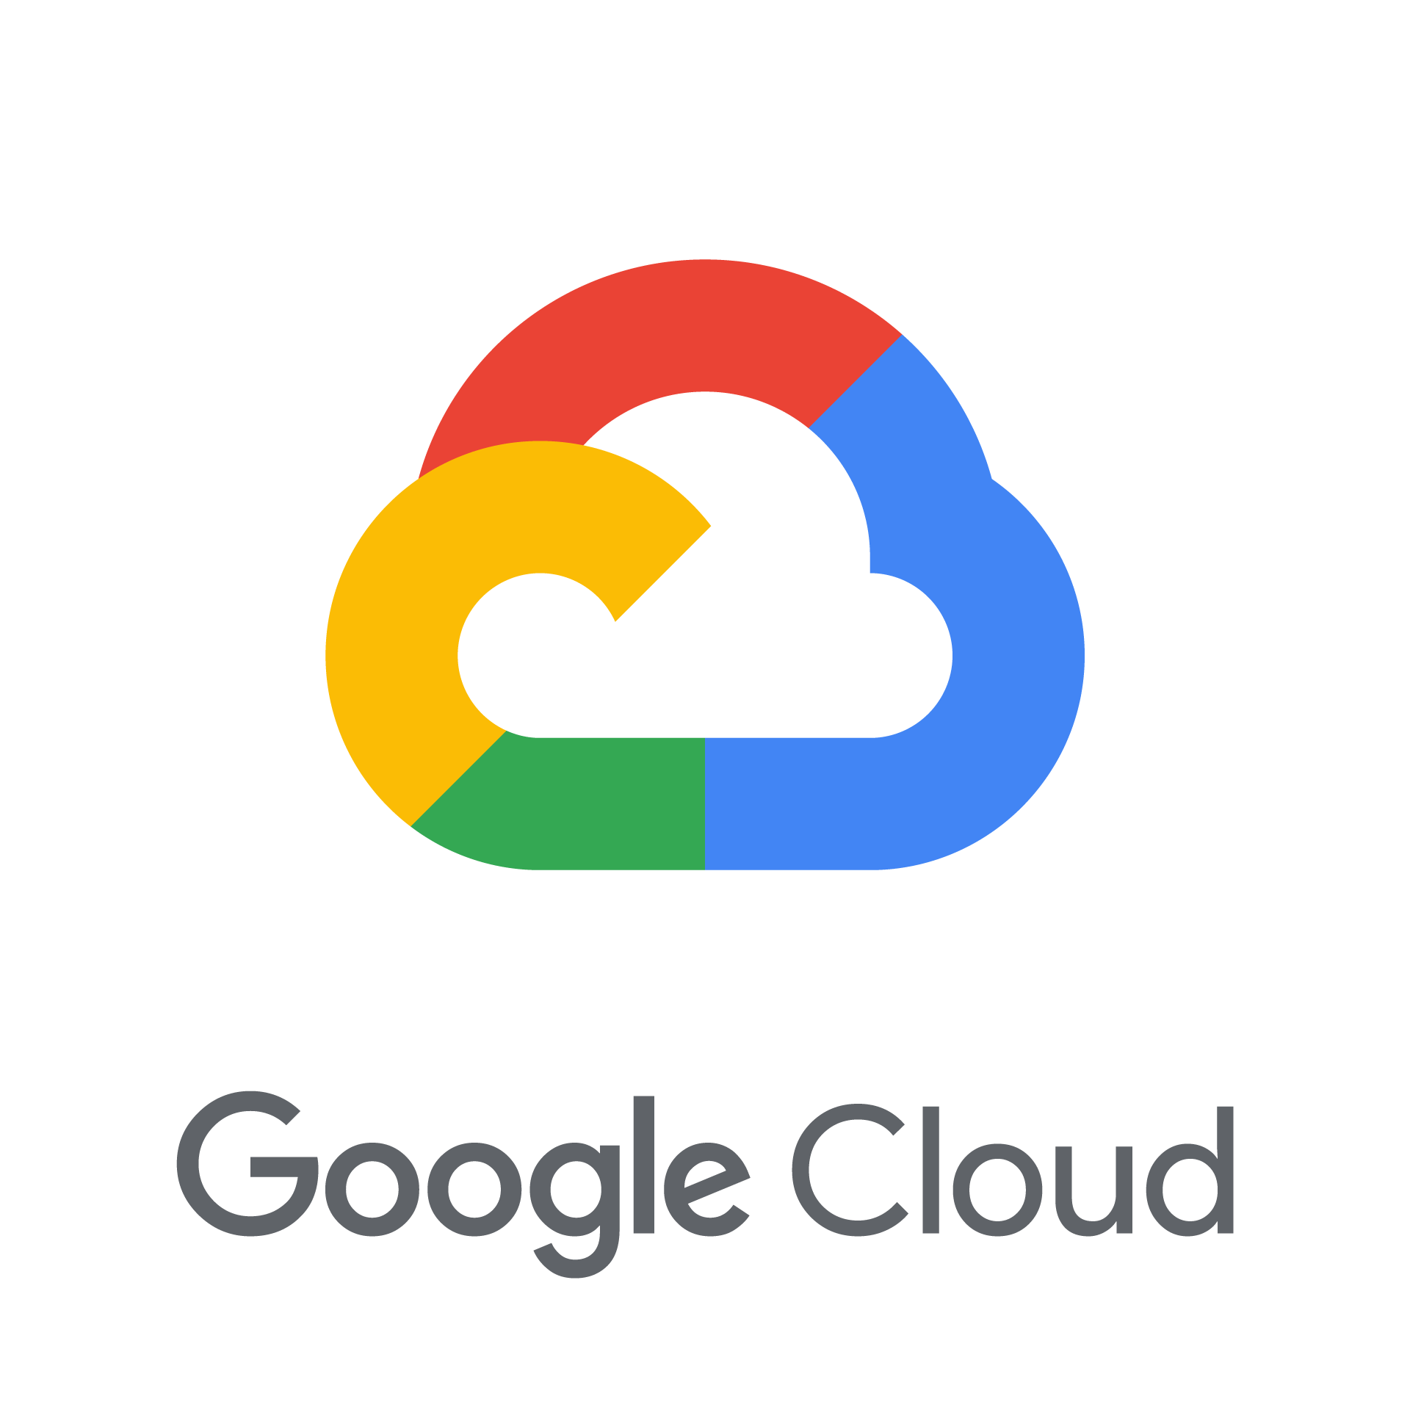

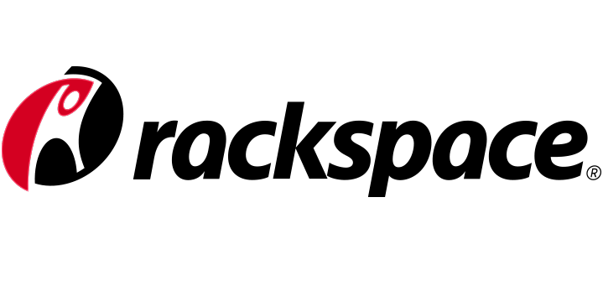
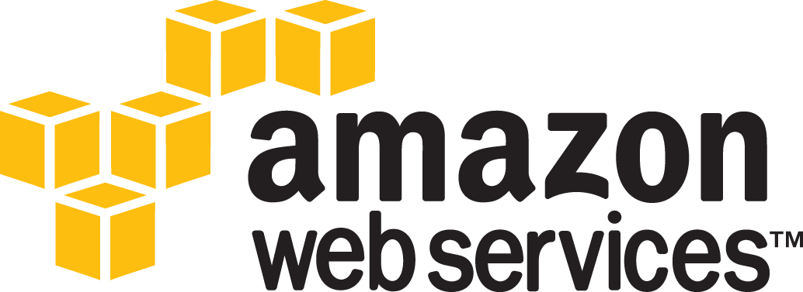

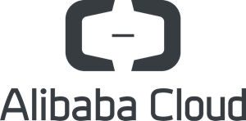
Infrastructure As A Service (IAAS)

Slide 40
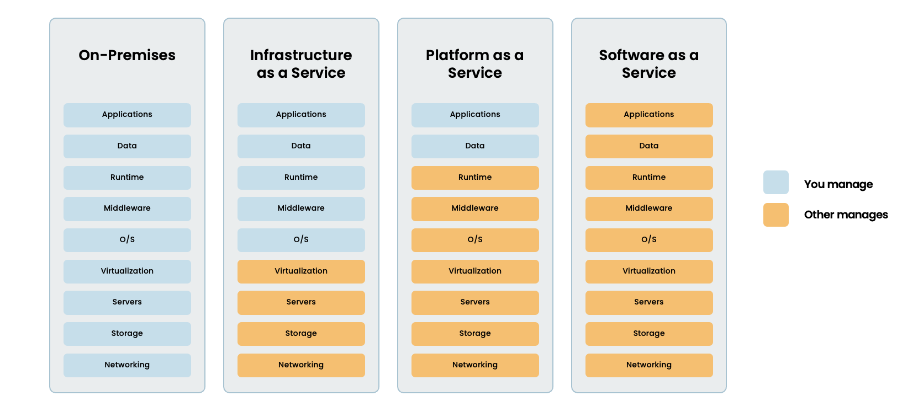

Slide 41
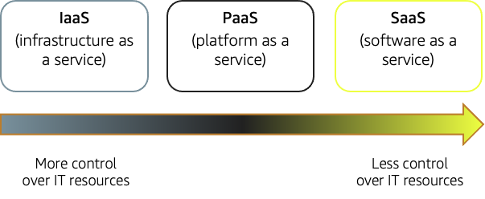

Slide 42
Dynamic Infrastructure
The ability to quickly adapt and reconfigure IT infrastructure resources as demands change.
Often enabled by virtualization, automation, and orchestration technologies.
Ensures optimal performance, cost efficiency, and high availability
Facilitates continuous integration and continuous deployment (CI/CD)

Slide 43
Key Components of Dynamic Infrastructure
Virtualization - Abstracts hardware into virtual resources (VMs or containers)
Automation - Scripts or tools to streamline provisioning, configuration, and scaling
Orchestration - Systems (like Kubernetes, Docker Swarm) that manage the lifecycle of multiple resources
Monitoring & Management - Tools to observe and adjust resource usage in real time (e.g., AWS CloudWatch, Azure Monitor)

Slide 44
Benefits of a Dynamic Infrastructure
Scalability
Easily add or remove resources in response to traffic or workload changes
Agility
Faster deployment of new applications and updates
Cost Optimization
Pay only for the resources actually in use
Fault Tolerance
Automatically shift workloads if a server or region fails

Slide 45
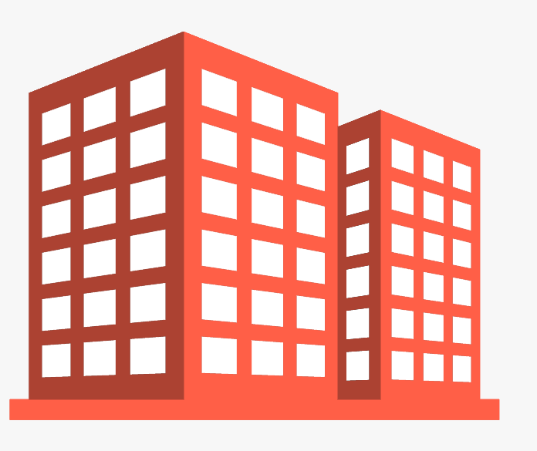
Izrulfizal Shoe Store
e-Commerce
HR System
CCTV
Financial System
HQ & Izrulfizal Shoe Store
Integrated SOP System
Business Monitoring

Slide 46
Izrulfizal Shoe Store
Traditional way:
- Weeks/months to setup the infrastructure
- Running business on paper
HQ & Izrulfizal Shoe Store

Slide 47
Izrulfizal Shoe Store
Modern way:
- Cloud hosting
- Server deployment in minutes
- Everything integrated
- Easy accessibility anytime
HQ & Izrulfizal Shoe Store

Slide 48
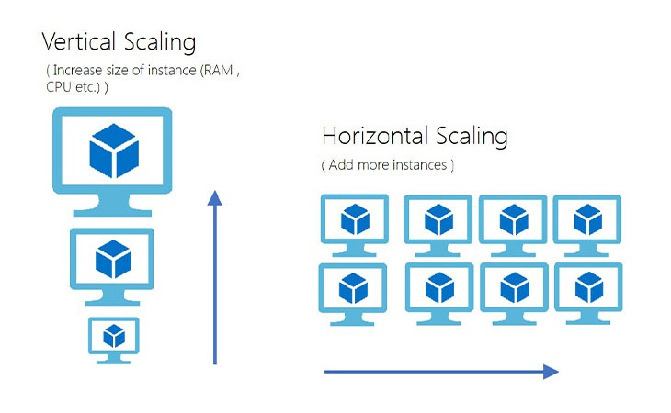

Izrulfizal Shoe Store
Heavy Traffics
Scalable
HQ & Izrulfizal Shoe Store

Slide 49
Challenges of Dynamic Infrastructure
Complexity
Multiple layers of abstraction can be difficult to manage
Skill Gap
Advanced knowledge required for automation/orchestration tools
Governance
Ensuring compliance and security policies in rapidly changing environments
Monitoring & Debugging
Dynamic scaling can make troubleshooting more complex

Slide 50
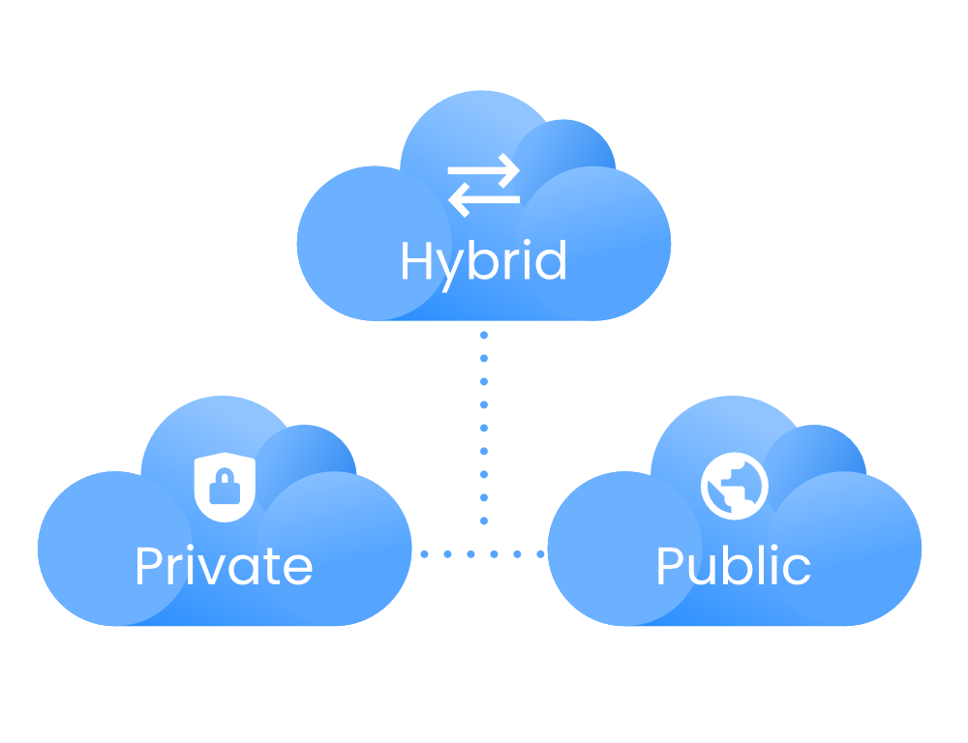
Type of Cloud Deployment
Another thing about Cloud Computing is how accessible it is. For this, we can differentiate cloud computing in three different ways :
Public Cloud
Private Cloud
Hybrid Cloud -
Mixture of Private & Public

Slide 51
Putting It All Together
Layered Approach Recap
SaaS: Complete software solutions provided to end users
PaaS: Platform that abstracts infrastructure and offers tools for development
IaaS: Core infrastructure (servers, storage, networking) delivered virtually
Dynamic Infrastructure - Underpins all these layers with flexibility and automation
Choosing the Right Model - Depends on your business needs, development expertise, and desired level of control

Slide 52
Summary
Cloud computing offers different service models (SaaS, PaaS, IaaS) to suit various needs.
Dynamic infrastructure enables scalability, agility, and cost-effectiveness.
Understand the trade-offs (control vs. complexity, cost vs. flexibility).

Slide 53

Topic 3
System Models and Enabling Technologies

Slide 54
Lecture Outline
System Scalability
Amdahl’s Law
System Availability
Single Point of Failure
Security Threats and Defense Technologies
Types of Attacks and Potential Damages
System Attacks and Network Threats
Internet Security Responsibilities
Case Studies

Slide 55
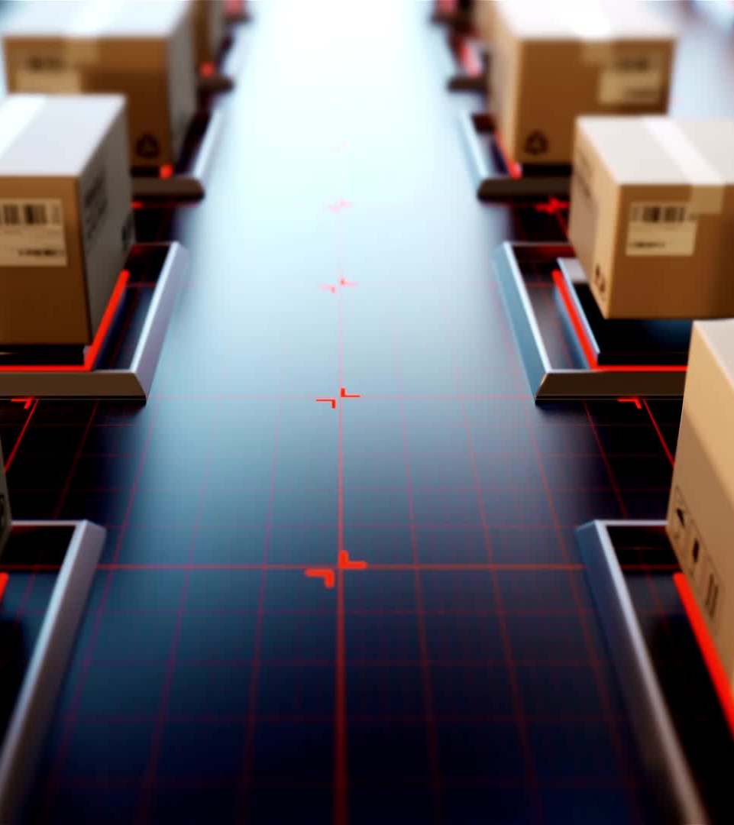
System Scalability
The capability of a system to handle an increasing load or demand without performance degradation.
Importance
Critical for system growth
Improved performance
Long-term sustainability.

Slide 56
Types of Scalability
Vertical Scalability: Enhancing existing resources, such as adding more CPU, RAM, or storage.
Horizontal Scalability: Expanding by adding more servers or devices.
Elastic Scalability: Automatically adjusting resources in response to demand.

Slide 57
Benefits of Scalability
Ensures consistent performance during peak loads.
Reduces system downtime and service disruptions.
Optimizes operational costs by scaling resources as needed.
Supports business growth and user demand.

Slide 58

Amdahl’s Law
Describes the limitations of speedup in parallel computing due to the serial portion of a task.
Formula: Speedup = 1 / (S + (1 - S)/N)
S = Fraction of the workload that must be executed serially
N = Number of processors

Slide 59

Amdahl’s Law
Scenario: A task where 40% is serial and 60% can be parallelized across 4 processors.
Speedup = 1 / (0.4 + (0.6/4)) = 2.22x faster.
Increasing processors has diminishing returns if the serial portion is significant.

Slide 60

System Availability
The degree to which a system is accessible and functional when needed.
Measured as: Availability (%) = (Uptime / Total Time) * 100

Slide 61
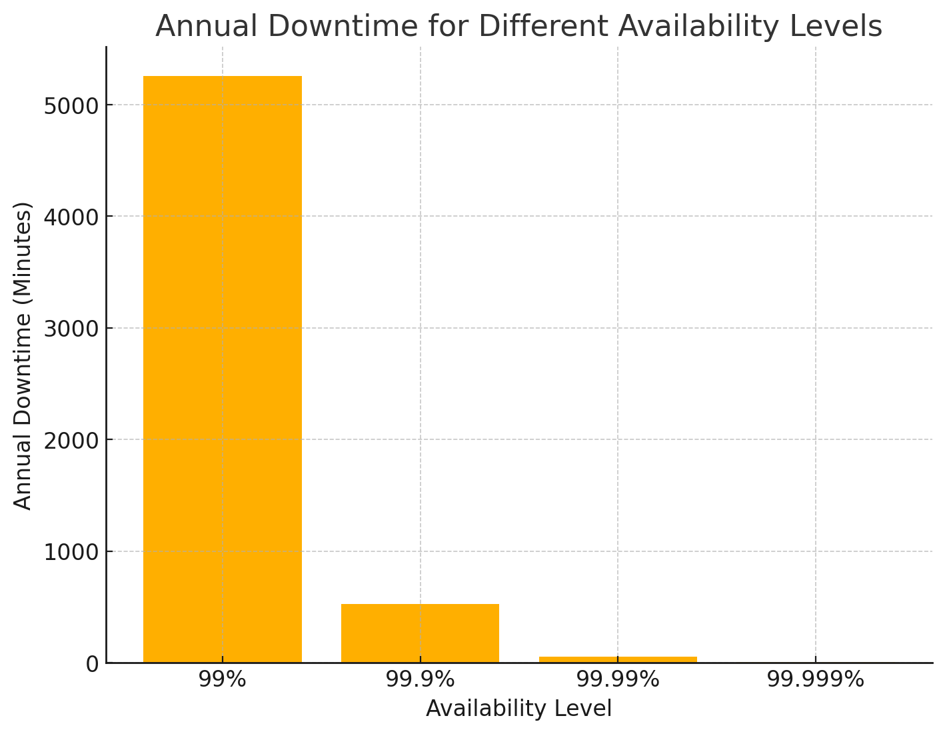
Common Avilability target

Slide 62
Factors Affecting System Availability
Hardware failures
Software bugs and crashes
Network disruptions
Maintenance and upgrades
Disaster events (natural disasters, cyberattacks)

Slide 63
Ensuring High Availability
Redundancy: Use backup components and systems.
Load Balancing: Distribute traffic to avoid overloading servers.
Failover Mechanisms: Automatically switch to standby systems during failures.
Monitoring: Continuous monitoring for quick issue detection.

Slide 64
Single Point of Failure (SPOF)
A component whose failure leads to total system shutdown.
Examples:
Single database server
Central router in a network
Power supply without backup

Slide 65
Mitigating SPOF
Use redundant components and backup systems.
Implement clustering and failover solutions.
Distribute services across multiple data centers.

Slide 66
Security Threats and Defense Technologies
Threats: Actions or events that compromise system integrity, confidentiality, or availability.
Defense Technologies:
Firewalls filter network traffic.
Intrusion Detection Systems (IDS) monitor suspicious activity.
Encryption secures data during transmission and storage.

Slide 67
Types of Security Threats
Malware: Viruses, worms, ransomware
Phishing: Fraudulent emails to steal information
DDoS: Overwhelming systems with excessive traffic
Man-in-the-Middle: Intercepting communications

Slide 68
Potential Damages from Attacks
Data breaches leading to loss of sensitive information
Financial losses due to business disruption
Reputational damage affecting customer trust
Legal consequences from non-compliance

Slide 69
System Attacks
Unauthorized Access: Gaining entry without permission
Privilege Escalation: Increasing access to sensitive areas
Insider Threats: Employees misusing access
Application Vulnerabilities: Exploiting bugs in software

Slide 70
Network Threats to Cyberspace
Packet Sniffing: Capturing data packets during transmission
IP Spoofing: Impersonating trusted devices
DNS Poisoning: Redirecting traffic to malicious sites
Zero-Day Exploits: Attacks exploiting undisclosed vulnerabilities

Slide 71
Defense Against Network Threats
Secure Protocols: Use HTTPS and VPNs for encryption
Network Segmentation: Isolate sensitive systems
Firewalls and IPS: Block unauthorized traffic
Patch Management: Regular software updates

Slide 72
Internet Security Responsibilities
Shared responsibility between individuals, organizations, and governments

Slide 73

Responsibilities of Individuals
Use strong, unique passwords
Enable two-factor authentication (2FA)
Avoid clicking on suspicious links

Slide 74

Responsibilities of Organizations
Develop comprehensive cybersecurity policies
Conduct regular employee training
Use encryption to protect data

Slide 75
Responsibilities of Governments
Enforce cybersecurity regulations and compliance
Establish national cybersecurity frameworks
Collaborate with international cybersecurity agencies

Slide 76

Case Study 1 - Equifax Data Breach
Event: In 2017, hackers stole sensitive information of 147 million individuals.
Cause: Vulnerability in a web application framework
Impact: Massive financial loss, legal actions, and reputational damage
Lesson: Regular vulnerability assessments and timely patching are critical.

Slide 77

Case Study 2 - WannaCry Ransomware Attack
Event: In 2017, a ransomware worm infected systems globally, encrypting data and demanding ransom payments.
Cause: Exploited a vulnerability in outdated Windows systems
Impact: Affected hospitals, businesses, and government agencies worldwide
Lesson: Keep systems updated and use robust backup solutions

Slide 78
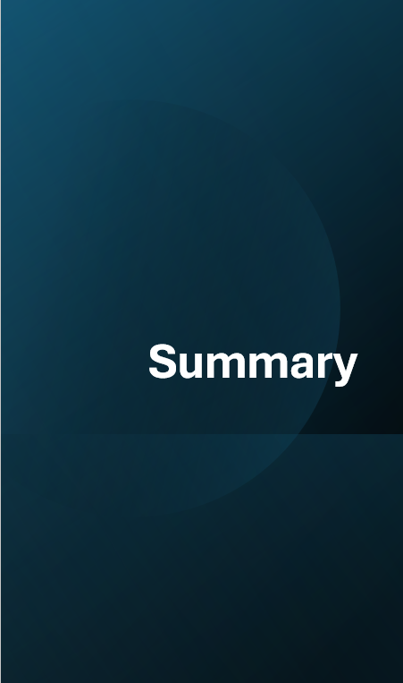
Summary
Scalability and availability are essential for system performance
Amdahl’s Law limits parallel computing benefits
Security threats must be countered with advanced defense technologies
Case studies highlight the importance of proactive cybersecurity

Slide 79
Topic 4 – Software as a Service (SaaS)
Understanding the SaaS Model, Examples, and Areas of Application

Slide 80
Introduction to SaaS
SaaS (Software as a Service) is a cloud computing model where applications are hosted by a provider and made available to users over the internet.
Key features:
No need for installation
Subscription-based pricing
Access from any device with internet
Provider manages infrastructure and updates

Slide 81
Evolution of Software Delivery
Traditional Model: Buy a license, install software on a local machine.
SaaS Model: Access software through a web browser, pay as you go.

Slide 82
SaaS Architecture
Multi-Tenancy: A single instance serves multiple customers.
Scalability: Can handle thousands of users without performance drop.
Automatic Updates: No manual upgrades needed.
Security & Compliance: Data encryption and access control managed by the provider.

Slide 83
SaaS vs Other Cloud Models
Feature | SaaS | PaaS | IaaS
Example | Gmail, Dropbox | Heroku, Google App Engine | AWS EC2, DigitalOcean
User Control | Least | Medium | Most
Maintenance | Managed by provider | User manages applications | User manages OS & apps
Use Case | Software applications | App development | Infrastructure for hosting

Slide 84
Benefits of SaaS
Cost-Effective: No upfront software purchase.
Accessibility: Use from any device, anywhere.
Scalability: Grow or shrink user base easily.
Security: Handled by professionals.
No Maintenance: No need to update or patch software.

Slide 85
Challenges of SaaS
Internet Dependency: No internet = no access.
Limited Customization: Some SaaS apps have restrictions.
Security Concerns: Data is stored by a third-party provider.
Vendor Lock-in: Difficult to migrate to another provider.

Slide 86
SaaS Pricing Models
Subscription-based (Monthly/Yearly) – Netflix, Office 365
Pay-as-you-go (Usage-based) – AWS Lambda, Twilio
Freemium (Basic free, paid premium features) – Dropbox, Slack

Slide 87
Examples of SaaS Applications
Productivity SaaS
Google Workspace (Docs, Sheets, Slides)
Microsoft 365
Dropbox
CRM SaaS
Salesforce
HubSpot
Zoho CRM

Slide 88
Examples of SaaS Applications
Communication SaaS
Slack
Zoom
Microsoft Teams
E-commerce SaaS
Shopify
BigCommerce
Wix

Slide 89
SaaS in Different Areas
1. SaaS in Business
Cloud-based accounting (QuickBooks)
HR & Payroll (BambooHR, Workday)
2. SaaS in Education
Online Learning (Coursera, Udemy)
Virtual Classrooms (Google Classroom)
3. SaaS in Healthcare
Electronic Health Records (EHR) systems (Athenahealth)
4. SaaS in Cybersecurity
Cloud-based security solutions (Cloudflare, Norton)

Slide 90
Choosing the Right SaaS Solution
Factors to Consider:
Pricing & Scalability
Security & Compliance
Integrations with other software

Slide 91
Risks & Security Concerns
Data Privacy: Ensure GDPR & compliance.
Downtime Risks: Choose reliable providers.
Cybersecurity Threats: Use MFA, encryption.

Slide 92
End of Topic 4
"The cloud is about how you do computing, not where you do computing." — Paul Maritz, Former CEO of VMware

Slide 93
Topic 5 – Cloud Infrastructure Management
Managing the Invisible Backbone of the Cloud

Slide 94

Introduction to Cloud Infrastructure
Cloud infrastructure includes:
Compute (VMs, containers)
Storage (block, object, file)
Network (virtual switches, routers)
Managed via web portals or APIs
Think of it like renting a fully furnished apartment. You don’t own the building (hardware), but you get everything you need inside (VM, storage, etc.)

Slide 95
Why Cloud Infrastructure Management Matters
Ensures resources are:
Available
Secure
Efficient
Prevents downtime and optimizes cost
Real-life example: Netflix uses cloud infrastructure to stream to millions. Without solid management, you'd be watching a spinning buffer wheel all day.

Slide 96

What is a Virtual Infrastructure Manager (VIM)?
- Software that manages virtualized resources in a cloud
Examples: OpenStack, VMware vSphere, Proxmox, Eucalyptus
Acts as the “invisible caretaker” of virtual resources

Slide 97
Core Features of a VIM
Provisioning VMs
Networking configuration
Storage management
Resource scheduling
Monitoring and logging
APIs for automation

Slide 98
Example – OpenStack as a VIM
Open-source VIM
Modular: Nova (compute), Neutron (network), Cinder (storage)
Scalable and customizable

Slide 99
VMware vSphere as a VIM
Enterprise-grade
Intuitive GUI
Integration with other VMware tools (vCenter, vSAN)

Slide 100
Feature Comparison of VIMs
Feature | OpenStack | VMware vSphere | Proxmox
Open-source | ✅ | ❌ | ✅
GUI | Moderate | Excellent | Good
Enterprise support | Moderate | Excellent | Moderate
Scalability | High | High | Medium

Slide 101
Advantages of Using Virtual Machines
Isolation between workloads
Better utilization of hardware
Snapshot & rollback
Disaster recovery
Portability

Slide 102
Purpose of Virtual Machines
Run multiple OS on one physical machine
Simulate different environments
Cost-efficient deployment

Slide 103
Benefits of Virtual Machines in Cloud
Scalability: Clone in minutes
Load balancing: Migrate VMs based on demand
Maintenance: Update without downtime

Slide 104
Opportunities in Cloud Infrastructure Management
Automated scaling
Multi-cloud strategy
AI-based resource optimization
Integration with DevOps (CI/CD)

Slide 105

Challenges in Cloud Infrastructure
Vendor lock-in
Complex configurations
Latency issues
Skills gap

Slide 106
Security Issues in Virtual Infrastructure
Hypervisor attacks
VM escape
Insecure APIs
Data breaches

Slide 107

Performance Issues
Overprovisioning
VM sprawl (too many unused VMs)
Resource contention

Slide 108

Cost Management Challenges
Pay-per-use can spiral
Unused VMs add cost
Lack of visibility = billing shocks

Slide 109
Disadvantages of Virtual Machines
Slower than containers
Resource overhead
Complex network setups
Longer boot times

Slide 110
How to Overcome the Challenges
Use automation tools (Ansible, Terraform)
Monitor usage and set alerts
Train staff continuously
Use hybrid cloud wisely

Slide 111

Cloud Management Best Practices
Document configurations
Use tagging and naming conventions
Regular cost reviews
Disaster recovery planning

Slide 112

Summary
Cloud infrastructure = virtualized compute, storage, and network
VIMs help manage resources
VMs offer isolation and flexibility
But also come with costs and complexity

Slide 113
Final Thoughts
“Managing cloud is like playing chess blindfolded… unless you have the right tools!”
Explore hands-on tools like:
VirtualBox
Proxmox
OpenStack DevStack
AWS Free Tier

Slide 114

Topic 6 - Migrating into the Cloud
Concepts, Challenges, Integration & Real-world Considerations

Slide 115

Cloud Migration
Cloud migration is the process of moving digital business operations into the cloud.
Involves moving data, applications, and IT processes from on-premises or legacy infrastructure to a cloud-based environment.
Can be done partially (hybrid) or fully (public/private cloud).

Slide 116
Reasons to Migrate to the Cloud
Scalability: Easily increase or decrease resources.
Cost Efficiency: Pay-as-you-go pricing reduces capital expenditure.
Performance: Improved speed, performance, and uptime.
Disaster Recovery: Built-in redundancy and failover options.
Remote Access: Access from anywhere using internet.

Slide 117
Types of Cloud Services
IaaS (Infrastructure as a Service): Provides virtualized computing resources via the internet (e.g., AWS EC2, Azure VM).
PaaS (Platform as a Service): Offers hardware and software tools for application development (e.g., Google App Engine).
SaaS (Software as a Service): Delivers software applications over the internet (e.g., Google Workspace, Dropbox).

Slide 118
Popular Cloud Providers
Amazon Web Services (AWS): Leader in global cloud market.
Microsoft Azure: Strong in hybrid cloud integration.
Google Cloud Platform (GCP): Known for data analytics and AI tools.
IBM Cloud, Oracle Cloud: Used in enterprise and legacy migration contexts.

Slide 119
Key Challenges in Cloud Migration
Downtime: Risk of application unavailability during migration.
Data Loss: Improper handling can lead to permanent data loss.
Security: Data in transit and at rest must be protected.
Compliance: Must meet regulatory requirements like GDPR, HIPAA.
Compatibility: Legacy apps may not run smoothly in cloud.

Slide 120
Planning
Business Goals: Define clear objectives (e.g., cost reduction, scalability).
Assessment: Evaluate existing infrastructure and dependencies.
Cost-Benefit Analysis: Weigh potential savings against migration costs.
Choose Cloud Model: Public, private, or hybrid?

Slide 121
The 6 R’s of Cloud Migration
Rehost
Lift and shift.
Refactor
Minor code changes to fit cloud environment.
Revise
Major changes to existing code.
Rebuild
Redesign from scratch.
Replace
Substitute with SaaS solutions.
Retire
Eliminate outdated components.

Slide 122
Rehost (Lift and Shift)
Move applications without modifying code.
Typically faster and less expensive.
Suitable for legacy systems that are hard to refactor.
Example: Moving a virtual machine from a local data center to AWS EC2.

Slide 123
Refactor (Replatform)
Make minimal changes to adapt the app to the cloud.
Improve performance or scalability.
Reuse existing code and frameworks.
Example: Moving an app to a managed database or using container services.

Slide 124
Revise (Re-architect)
Modify or extend existing code base.
Required when existing code is not optimized for cloud.
Prepares for better long-term cloud-native benefits.
Example: Splitting a monolithic app into microservices.

Slide 125
Rebuild (Redesign from Scratch)
Complete rewrite of the application.
Highest cost and time investment.
Best option for outdated or inefficient legacy systems.
Example: Rebuilding an HR system using cloud-native frameworks.

Slide 126
Replace (Drop and Shop)
Replace your in-house app with SaaS.
Avoids development cost and effort.
Fast deployment and maintenance.
Example: Switching to Salesforce instead of running your own CRM.

Slide 127
Retire (Decommissioning)
Identify and eliminate applications no longer needed.
Frees up resources.
Reduces complexity and cost.
Example: Retiring an old reporting tool replaced by BI dashboards in cloud.

Slide 128
Steps to Cloud Migration
Create a Migration Strategy
Evaluate Applications and Data
Choose the Right Cloud Provider
Prepare the Environment
Migrate and Test
Monitor and Optimize

Slide 129
Step 1 - Create a Migration Strategy
Define the business objectives for moving to the cloud.
Determine scope, timeline, and budget.
Identify stakeholders and assign responsibilities.

Slide 130
Step 2 - Evaluate Applications and Data
Audit existing infrastructure.
Classify applications based on criticality and complexity.
Identify dependencies and compliance requirements.

Slide 131
Step 3 - Choose the Right Cloud Provider
Compare pricing models, SLAs, and services offered.
Consider support, security features, and compliance certifications.
Evaluate existing provider integrations and ecosystem compatibility.

Slide 132
Step 4 - Prepare the Environment
Set up
Set up accounts, access policies, and permissions.
Design
Design network architecture and storage.
Implement
Implement identity and access management (IAM).

Slide 133
Step 5 - Migrate and Test
Begin with low-risk applications as a pilot.
Execute the migration using tools and automation.
Validate the system functionality through rigorous testing.

Slide 134
Step 6 - Monitor and Optimize
Monitor usage, performance, and security.
Tune systems for cost and performance efficiency.
Implement alerts and analytics dashboards.

Slide 135
Migration Tools & Platforms
AWS Migration Hub
Azure Migrate
Google Migrate for Compute Engine
CloudEndure, Velostrata

Slide 136
Limitations That Deter Adoption
Poor Connectivity: Limits real-time access.
Legacy Dependencies: Older apps may resist change.
Lack of Cloud Talent: Skilled professionals are in demand.
Concerns over Vendor Lock-in

Slide 137
Cloud Integration Types
Data Integration: Synchronize data across systems.
Application Integration: Connect disparate apps for workflow.
Process Integration: End-to-end business process automation.

Slide 138
Data Integration
Combines data from different sources into a single, unified view.
Supports real-time or batch synchronization between databases and storage.
Ensures consistency, quality, and availability of business-critical data.
Example: Syncing product inventory data between a cloud-based e-commerce platform and an on-premises ERP system.

Slide 139
Application Integration
Connects different applications to work together.
Facilitates communication and data exchange across platforms.
Enables automation of workflows that span multiple systems.
Example: Integrating Salesforce (CRM) with Mailchimp (Email Marketing) to auto-send customer emails after a sales update.

Slide 140
Process Integration
Aligns business processes across applications and departments.
Streamlines multi-step workflows that depend on input/output from different systems.
Often managed through orchestration or Business Process Management (BPM) tools.
Example: An order placed on an e-commerce platform triggers inventory check, invoicing, and shipment tracking—spanning several apps.

Slide 141
Requirements for Integration
Secure APIs
Real-time and Batch Processing Support
Data Transformation
Monitoring and Logging

Slide 142
Attributes of Integration Platforms
Scalability:
Must handle growing data.
Interoperability:
Work with multiple environments.
Security:
Data encryption and compliance support.
Ease of Use:
Low-code/drag-drop preferred.

Slide 143
What is Jitterbit Integration Server?
Low-code iPaaS (Integration Platform as a Service)
Supports connecting cloud and on-premise systems.
Visual data mapping and transformation.
Real-time and scheduled integrations.

Slide 144
Risks in Cloud Migration
Vendor Lock-in
Budget Overruns
Service Disruptions
Loss of Governance
Incompatibility

Slide 145

Mitigation Strategies
Use Open Standards/APIs
Document Everything
Start with Pilot Projects
Regular Testing and Backup

Slide 146
Post-Migration Considerations
Monitoring and Logging
Performance Optimization
Security Policy Updates
User Training
Periodic Audits

Slide 147
Cloud Messaging Queuing
Message Queuing: Temporarily holds messages for processing.
Decouples Components: Producer and consumer run independently.
Improves Reliability: Handles spikes without overloading systems.

Slide 148
Examples of Messaging Queuing Tools
Amazon SQS: Reliable queue service for distributed apps.
Apache Kafka: High-throughput distributed messaging.
RabbitMQ: Lightweight and flexible broker.
Azure Queue Storage

Slide 149
Summary of Key Points
Cloud migration is complex but rewarding
Choose the right model and tools
Integrate thoughtfully
Be aware of risks and mitigate them
Use messaging queues for better architecture

Slide 150
Topic 7 - Infrastructure as a Service (IaaS) Providers
Exploring Features, Technologies, and Leading Providers

Slide 151
Introduction to IaaS
Infrastructure as a Service (IaaS) is a form of cloud computing that provides virtualized computing resources over the internet. With IaaS, businesses can rent servers, storage, and networking infrastructure on-demand, rather than owning and maintaining physical data centers. It provides maximum control over operating systems, storage, and deployed applications, making it ideal for system administrators and developers.
This model lays the foundation for understanding how modern cloud infrastructures are structured and consumed, leading into a comparison with other cloud service models.

Slide 152
IaaS in Cloud Models
IaaS is one of the three main cloud service models: IaaS, PaaS, and SaaS. It offers the highest level of flexibility and management control.
Understanding IaaS's position helps us appreciate the unique features that make it suitable for specific use cases, which we will now explore.

Slide 153
Key Features of IaaS
On-demand Self-Service: Users can provision resources as needed.
Resource Pooling: Providers pool computing resources to serve multiple clients.
Rapid Elasticity: Scale resources up or down quickly.
Measured Service: Pay only for what you use. These features enable agility and cost-efficiency.

Slide 154
Elasticity and Scalability
Elasticity refers to the ability of a system to automatically scale in or out depending on demand. For example, during a major sales event, an e-commerce site can automatically add servers to handle increased traffic, and reduce them once traffic returns to normal—ensuring cost optimization and performance stability.
To enable this kind of flexibility, IaaS depends heavily on virtualization.

Slide 155
Virtualization Technology
IaaS heavily relies on virtualization to abstract hardware resources. Virtual machines (VMs) are created on physical servers using hypervisors such as VMware ESXi, Xen, KVM, or Hyper-V. This enables multiple users to share the same physical hardware securely and efficiently, reducing hardware costs and improving scalability.
Since IaaS infrastructure spans the globe, let’s now look at the importance of where this infrastructure is physically located.

Slide 156
Geographic Presence
Most IaaS providers have a global network of data centers. These are grouped into geographic regions and availability zones. The wider the presence, the more options a business has to place data closer to users—reducing latency and meeting data residency laws.
But having global data centers alone isn’t enough—strategic placement plays a crucial role, as we’ll now see.

Slide 157
Importance of Data Center Location
Choosing a data center location is crucial for performance and compliance. For instance, a company targeting Asian customers might choose a Singapore or Tokyo region. Data locality also affects legal compliance, e.g., GDPR compliance in Europe.
Once a location is selected, users need methods to interact with and manage their infrastructure.

Slide 158
User Interfaces and Access to Servers
Web-based dashboards (e.g., AWS Management Console)
Command-line tools (e.g., Azure CLI, AWS CLI)
RESTful APIs and SDKs for automation This variety ensures accessibility for both beginners and advanced users.

Slide 159
Interfaces in Practice
For example, DevOps teams often use APIs or tools like Terraform to automatically create and manage infrastructure as code. This automation improves consistency and reduces human error in large deployments.
Let’s now consider how some businesses plan ahead and save costs through capacity reservation.

Slide 160
Advanced Reservation of Capacity
IaaS providers often offer reserved instances at a lower cost compared to on-demand instances. This is useful when you have predictable workloads. For instance, a business with a steady monthly traffic pattern can reserve capacity in advance and save up to 70%.
To see how this works in practice, consider a real-world academic use case.

Slide 161
Real-World Example of Reservation
Imagine a university hosting an exam portal every semester. Since they know the exact dates of high usage, they can reserve capacity in advance, ensuring both cost savings and availability.
But what happens when usage patterns are unpredictable? That’s where auto scaling and load balancing come in.

Slide 162
Auto Scaling and Load Balancing
Auto Scaling automatically adjusts the number of VM instances to meet demand. Load Balancing distributes traffic evenly across instances. Together, they ensure high availability, fault tolerance, and cost efficiency during variable load conditions.
This is especially crucial for applications facing sudden traffic spikes, like e-commerce websites.

Slide 163
E-commerce Example
During flash sales, a fashion website may receive traffic spikes. Auto scaling adds more servers to handle the surge, and the load balancer routes users across these servers to prevent crashes, ensuring a smooth customer experience.
To guarantee performance, these services are backed by formal agreements known as SLAs.

Slide 164
Understanding SLAs
Service-Level Agreements define the expected level of service, typically including uptime (e.g., 99.99%), response times, and support levels. SLAs build trust and set accountability between provider and customer. Breaching SLAs may result in service credits.
The implications of these agreements are significant—especially for mission-critical applications.

Slide 165
SLA Implications
If a provider promises 99.99% uptime, this means only about 52 minutes of downtime per year is acceptable. Applications requiring high availability, like online banking, must evaluate SLAs critically before choosing a provider.
Underpinning these performance commitments is the technology that manages VMs—hypervisors.

Slide 166
Hypervisors Overview
Hypervisors manage VMs and are classified into:
Type 1: Bare-metal (e.g., Xen, VMware ESXi)
Type 2: Hosted (e.g., VirtualBox) Type 1 hypervisors are more secure and commonly used in data centers. AWS uses a customized version of Xen and Nitro.
Hypervisors enable the use of multiple operating systems.

Slide 167
Operating System Choices
Users can install any OS, such as Ubuntu, CentOS, Red Hat, or Windows Server. This flexibility supports a wide variety of use cases—from hosting websites on Linux to running legacy enterprise apps on Windows.
Now that we understand the core technology, let's examine the major players offering these services.

Slide 168
Introduction to IaaS Providers
Several key players dominate the IaaS space, each with unique strengths:
Amazon Web Services (AWS)
Flexiscale
Joyent
Rackspace We’ll now explore each in more detail to compare what they bring to the table.

Slide 169

Amazon Web Services (AWS)
AWS is the largest and most widely used IaaS provider. It offers a vast array of services beyond compute and storage, including AI, IoT, and big data analytics. AWS supports global infrastructure with 30+ geographic regions.
Let’s take a closer look at one of AWS's flagship IaaS offerings—Amazon EC2.

Slide 170
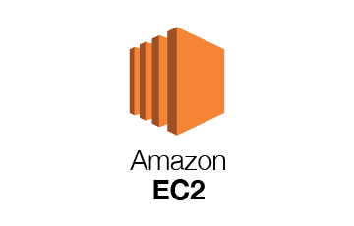
Amazon EC2 Features
Elastic Compute Cloud (EC2) allows you to launch virtual servers on-demand. Features include:
Variety of instance types (General, Compute, GPU)
Elastic IPs
AMIs (Amazon Machine Images)
Integration with Auto Scaling, ELB, CloudWatch

Slide 171
EC2 Use Cases
A startup can launch a web app with minimal upfront cost.
Research teams can run machine learning models on spot instances.
Enterprises can deploy scalable microservices architecture.
Beyond AWS, there are other notable providers with unique features worth examining.

Slide 172
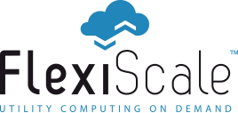
Flexiscale Overview
Flexiscale was among the first cloud IaaS platforms. It emphasized ease of use, GUI-based management, and real-time provisioning. It laid the groundwork for future European cloud innovations.

Slide 173
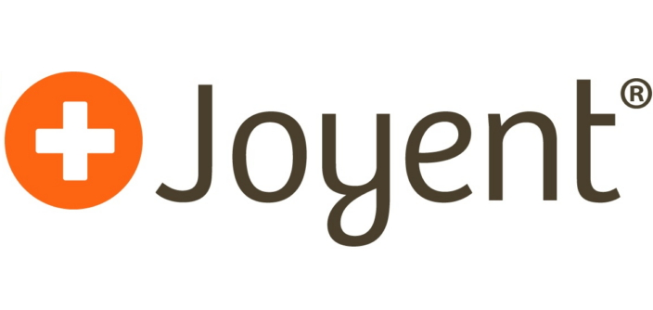
Joyent Overview
Joyent provides SmartOS-based virtual machines optimized for real-time apps. Known for supporting Node.js early, Joyent is now part of Samsung and focuses on cloud-native workloads and high-performance computing.

Slide 174
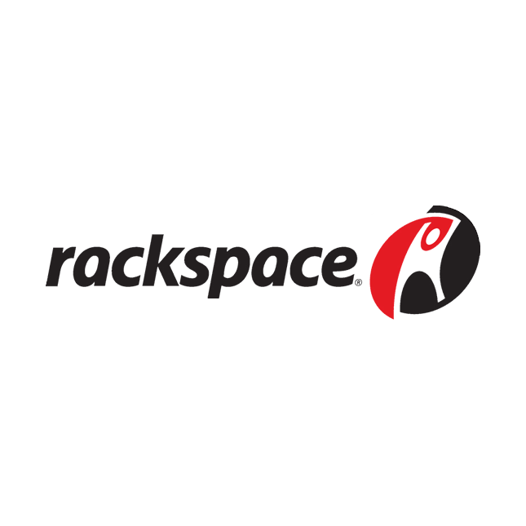
Rackspace Cloud Servers
Rackspace specializes in managed cloud services. It helps businesses deploy and manage cloud infrastructure on platforms like AWS, Azure, and Google Cloud. Their focus is on customer support, making them ideal for companies with limited IT staff.

Slide 175
Comparing Providers
Feature | AWS | Flexiscale | Joyent | Rackspace
Global Reach | High | Low | Moderate | High
Support | Good | Moderate | Developer-focused | High-touch
Pricing Flexibility | High | Medium | Medium | Low
OS Flexibility | Broad | Broad | SmartOS | Broad

Slide 176
Choosing the Right IaaS
Cost predictability
Performance and availability needs
Compliance requirements
In-house expertise A healthcare startup might choose AWS for scalability, while a small firm might pick Rackspace for its support.

Slide 177
Real-World Applications of IaaS
Education: Virtual labs, student VMs
E-commerce: Scalable web stores
Media: Video rendering farms
Government: Secure data processing These use cases highlight the flexibility of IaaS across sectors.

Slide 178
Challenges with IaaS
Cost overruns without monitoring
Data security risks if misconfigured
Vendor lock-in
Complexity in setup and scaling These should be planned for during adoption.

